Slide 1

Theory of Computation
CSE ( CET2008B)
TY BTech
Unit IV
Turing Machine

Slide 2
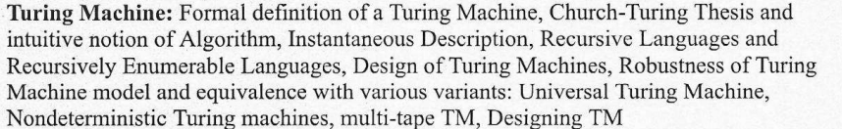
Unit IV
Turing Machine

Slide 3

Course Objective & Course Outcomes
Course Objectives:
  To Study computing machines by describing, classifying and comparing different types of computational models.
  Encourage students to study Theory of Computability and Complexity.
Course Outcomes:
After successful completion of this course students will be able to:
Construct finite state machines to solve problems in computing
Write mathematical expressions for the formal languages
Apply well defined rules for syntax verification
Construct and analyze Push Down, Post and Turing Machine for formal languages
Express the understanding of the decidability and Undecidability problems
Express the understanding of computational complexity.

Slide 4
Text Books & Reference Books
Text Books
Michael Sipser “Introduction to the Theory of Computation” CENGAGE Learning, 3rd Edition ISBN-13:978-81-315-2529-6
Vivek Kulkarni, “Theory of Computation”, Oxford University Press,
ISBN-13: 978-0-19-808458-7
Reference Books
Hopcroft Ulman, “Introduction To Automata Theory, Languages And Computations”, Pearson Education Asia, 2nd Edition
Daniel. A. Cohen, “Introduction to Computer Theory” Wiley-India, ISBN:978-81-265-1334-5
K.L.P Mishra ,N. Chandrasekaran ,“Theory Of Computer Science (Automata, Languages and Computation)”, Prentice Hall India,2nd Edition
John C. Martin, “Introduction to Language and Theory of Computation”, TMH, 3rd Edition ISBN: 978-0-07-066048-9
Kavi Mahesh, “Theory of Computation: A Problem Solving Approach”, Wiley-India, ISBN: 978-81-265-3311-4

Slide 5
Church-Turing’s Thesis
Everything that is algorithmically computable is computable by a Turing machine

Slide 6
Turing Machine
Invented by Alan Turing in 1936
A simple mathematical model of a general purpose computer
It is capable of performing any calculation which can be performed by any computing machine

Slide 7
The Language Hierarchy
_{a}n_{b}n_{c}n ? ww ?
Context-Free Languages
_{a}n_{b}n
ww^{R}
Regular Languages
a *
a * b *

Slide 8

Language Accepted by TM
_{a}n_{b}n_{c}n ww
Context-Free Languages
_{a}n_{b}n
ww^{R} NDPA
Regular Languages
Finite
a *
a * b *
Automata

Slide 9
Elements of a Turing Machine
A TM consists of the following:
  A tape head : read / write a symbol at a time, move to left/right
  An infinite tape: contains square cells in which symbols can be written
  A finite set of symbols
  A finite set of states
Finite control
… B B X₁ X₂ … X_{i} X_{n} B B …
Notes:
9

Slide 10
Turing Machine
A TM consists of a finite control (i.e. a finite state automaton) that is connected to an infinite tape.
Initially the input consists of a finite-length string of symbols and is placed on the tape.
To the left of the input and to the right of the input, extending to infinity, are placed blanks.
The tape head is initially positioned at the leftmost cell holding the input.
Finite control
… B B X₁ X₂ … X_{i} X_{n} B B …
Notes:
10

Slide 11
Turing Machine
In one move the TM will:
    Change state, which may be the same as the current state
    Write a tape symbol in the current cell, which may be the same as
    the current symbol
    Move the tape head left or right one cell

Slide 12
Formal Definition of TM
Formally, the Turing Machine is denoted by the 7-tuple:
  M = (Q, ∑, Γ, δ, q₀, B, F)
Q = finite states of the control
∑ = finite set of input symbols, which is a subset of Γ below
Γ = finite set of tape symbols
δ = transition function. δ : (Q x Γ) -> (Q x Γ x D)
e.g. δ(q, X) = (p, Y, {L, R, N})
Where p = next state, Y = new symbol written on the tape,
D = direction to move the tape head(left, right, No move)
q₀= start state for finite control
B = blank symbol. This symbol is in Γ but not in ∑.
F = set of final or accepting states of Q.
Notes:
12

Slide 13
The Tape
No boundaries -- infinite length
...... |  |  |  |  |  |  |  |  |  | ......
Read-Write head
The head moves Left or Right

Slide 14
The Tape
...... |  |  |  |  |  |  |  |  |  | ......
Read-Write head
The head at each time step:
Reads a symbol
Writes a symbol
Moves Left or Right

Slide 15
Transition Function
Takes two arguments:
  A state, in Q
  A tape symbol in Γ
δ(q, Z) is either undefined or a triple of the form (p, Y, D) where
  p is a state
  Y is the new tape symbol
  D is a direction, L or R

Slide 16
Example:
Time 0
...... |  |  | a | b | a | c |  |  |  | ......
Time 1
Reads a
Writes k
Moves Left
...... |  |  | a | b | k | c |  |  |  | ......

Slide 17
Time 1
...... |  |  | a | b | k | c |  |  |  | ......
Time 2
...... |  |  | a | f | k | c |  |  |  | ......
Reads b
Writes
f
3. Moves Right

Slide 18
The Input String
Input string
Blank symbol
...... |  |  | a | b | a | c |  |  |  | ......
␢
␢
␢
␢
␢
head
Head starts at the leftmost position of the input string
‘␢’
are treated as left and right brackets for the input written on the tape.

Slide 19
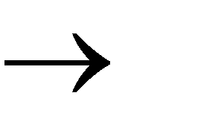
States & Transitions
Write
Read
Move Left
a b, L
q₁
q₂
Move Right
a b, R
q₁
q₂

Slide 20
...... |  |  | a | b | a | c |  |  |  | ......
␢
␢
␢
␢
␢
Example:
q₁
current state
a b, R
q₁
q₂

Slide 21
Time 1
q₁
Time 2
q₂
...... |  |  | a | b | a | c |  |  |  | ......
␢
␢
␢
␢
␢
␢
...... |  |  | a | b | b | c |  |  |  | ......
␢
␢
␢
␢
a b, R
q₁
q₂

Slide 22
Time 1
q₁
Time 2
q₂
...... |  |  | a | b | a | c |  |  |  | ......
␢
␢
␢
␢
␢
␢
...... |  |  | a | b | b | c |  |  |  | ......
␢
␢
␢
␢
a b, L
q₁
q₂

Slide 23
Time 1
q₁
Time 2
...... |  |  | a | b | a | c |  |  |  | ......
␢
␢
␢
␢
␢
␢
...... |  |  | a | b | b | c |  |  |  | ......
␢
␢
g
␢
q₂
g, L
q₁
␢
q₂

Slide 24
Instantaneous Descriptions(ID) of a Turing Machine
Sometimes it is useful to describe what a TM does in terms of its ID (instantaneous description), just as we did with the PDA
The ID shows all non-blank cells in the tape, pointer to the cell the head is over with the name of the current state
  use the turnstile symbol ├ to denote the move.
  As before, to denote zero or many moves, we can use ├*

Slide 25
Instantaneous Descriptions(ID) of a TM
␢
␢
␢
␢
(1) For constructing the ID, we simply insert the current state in the input string to the left of the symbol under the R/W head.
(2) We observe that the blank symbol may occur as part of the left or right
substring.

Slide 26
␢
␢
␢
␢
␢
␢
Fall 2006
Costas Busch - RPI
26

Slide 27
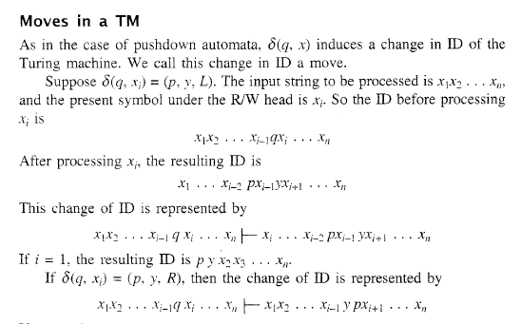
Instantaneous Descriptions(ID) of a TM

Slide 28
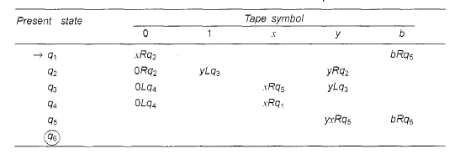
Example

Slide 29
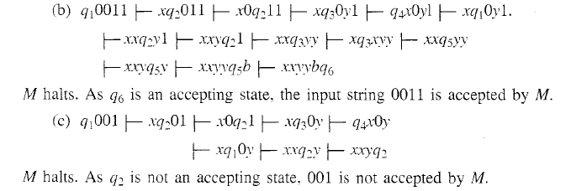

Slide 30
Acceptance of Input
If machine halts
in a final state
Accept Input
If machine halts
in a non-final state
or
If machine enters an infinite loop
Reject Input

Slide 31
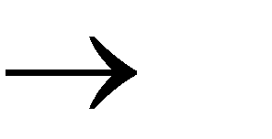
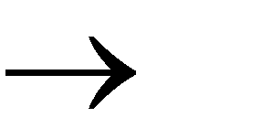
Example 1 :aa*
a a, R
␢
␢
, L
q₀
q₁

Slide 32
 |  |  | a | a | a
␢
␢
␢
␢
␢
q₀
a a, R
␢
␢
, L
q₀
q₁

Slide 33
 |  |  | a | a | a
␢
␢
␢
␢
q₀
a a, R
␢
␢
, L
q₀
q₁

Slide 34
 |  |  | a | a | a
␢
␢
␢
␢
q₀
a a, R
␢
␢
, L
q₀
q₁

Slide 35
 |  |  | a | a | a
␢
␢
␢
␢
q₀
a a, R
␢
␢
, L
q₀
q₁

Slide 36
 |  |  | a | a | a
␢
␢
␢
␢
q₁
a a, R
Halt & Accept
␢
␢
, L
q₀
q₁

Slide 37
Rejection Example
Time 0
q₀
a a, R
 |  |  | a | b | a
␢
␢
␢
␢
␢
␢
, L
q₀
q₁

Slide 38
 |  |  | a | b | a
Time 1
␢
␢
␢
␢
q₀
No possible Transition
Halt & Reject
a a, R
␢
␢
, L
q₀
q₁

Slide 39
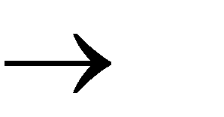
Infinite Loop Example
b b, L
a a, R
␢
␢
, L
q₀
q₁

Slide 40
 |  |  | a | b | a
␢
␢
␢
␢
q₀
b b, L
a a, R
␢
␢
, L
q₀
q₁

Slide 41
 |  |  | a | b | a
␢
␢
␢
␢
q₀
b b, L
a a, R
␢
␢
, L
q₀
q₁

Slide 42
 |  |  | a | b | a
␢
␢
␢
␢
q₀
b b, L
a a, R
␢
␢
, L
q₀
q₁

Slide 43
Time 2
 |  |  | a | b | a
␢
␢
␢
␢
q₀
 |  |  | a | b | a
Time 3
␢
␢
␢
␢
q₀
 |  |  | a | b | a
Time 4
␢
␢
␢
␢
q₀
 |  |  | a | b | a
Time 5
␢
␢
␢
␢
q₀
... Infinite Loop

Slide 44
Because of the infinite loop:
The final state cannot be reached
The machine never halts
The input is not accepted

Slide 45
Design of TM steps
1. Definition of TM
2. Logic
3. Transition function
4. Instantaneous Description of a string

Slide 46
Turing Machine Examples
1. Design TM to recognize all strings of even number of 1’s. Assume the string is made up of only 1’s
Solution
M = ({q₀, q₁}, {1}, {1}, δ, q0, B, {q₀})
 | 1 | B
q₀ | q₁BR | Accept
q₁ | q₀BR | Reject
Instantaneous Description: w= 1111
q₀1111B |- B q₁111B |- BBq₀11B |- BBB q₁1B|- BBBBq₀B|- Accept

Slide 47
Turing Machine Examples
2. Design a TM which can compute a concatenation function over ∑={1}
If the pair of words {w1,w2} is the input, output has to be w1w2.
Solution
M = ({q₀, q₁}, {1}, {1}, δ, q0, B, {q₀})
Logic: Replace separating symbol ‘B’ by ‘1’
Replace rightmost ‘1’ by ‘B’
δ:
B | 1 | 1 | B | 1 | 1 | 1 | B
B | 1 | 1 | 1 | 1 | 1 | B | B
 | 1 | B
q₀ | q₀1R | q₁1R
q₁ | q₁ 1R | q₂BL
q2 | q₃BR
*q3 |  | Accept

Slide 48
Turing Machine Examples
3. Design TM that will replace every occurrence of substring 11 by 10 keeping everything intact
Solution
M = ({q₀, q₁}, {0,1}, {0,1}, δ, q₀, B, {q₀})
 | 0 | 1 | B
q₀ | q₀0R | q₁1R | Accept
q₁ | q₀0R | q₀0R | Accept
Instantaneous Description: w= 01101110110

Slide 49
4. Design a TM for L= {0^{n}1^{n} |n>=1}
 | 0 | 1 | x | y | B
q₀ | q₁, x, R | - | - | q₃, y, R | q_{4,} B, N(accept)
q₁ | q₁, 0, R | q₂, y, L | - | q₁, y, R | -
q₂ | q₂, 0, L | - | q₀, x, R | q₂, y, L | -
q₃ | - | - | - | q₃, y, R | q₄, B, R(accept)
q₄ | - | - | - | - | -
Instantaneous Description: w= 0011

Slide 50
Practice Problems
5. Design TM that recognizes strings containing equal number of 0’s and 1’s
6. Design TM that checking if a set of parentheses are well-formed

Slide 51
Turing Machine Examples
5. Design TM that recognizes strings containing equal number of 0’s and 1’s
Solution
M = ({q₀, q_{1,} q₂, q_{3,} q₄}, {0,1}, {0,1, *}, δ, q₀, B, {q₀})
Instantaneous Description: w= 01101110110
 | 0 | 1 | * | ;
q₀ | q₁*R | q₃*R | q₀*R | q₄N(Accept)
q₁ | q₁0R | q₂*L | q₁*R | q₄N(Reject)
q₂ | q₂0L | q₂1L | q₂*L | q₀ ; R
q₃ | q₂*L | q₃1R | q₃*R | q₄N(Reject)
q₄ | - | - | - | -

Slide 52
Turing Machine Examples
6. Design TM that checking if a set of parentheses are well-formed
M = ({q₀, q_{1,} q₂, q_{3,}}, {(,)}, {(,), *, ;, O, R_{p}, L_{p}}, δ, q₀, B, {q₃})
Simplified Functional Matrix:
 | ( | * | ) | ; | Rp | Lp | O
q₀ | R | R | q₁*L | q₂L | - | - | -
q₁ | q₀*R | L | L | q₃R_{p}N | - | - | -
q₂ | q₃L_{p}N | L | L | q₃ON | - | - | -
q₃ | Final state
Instantaneous Description: w= (( ))

Slide 53
( R
) * L
* L
q₀
q₁
* R
( * R
) L
; L
; R_{p} N
( L_{p} N
* L
q₂
q₃
Halt
) L
; O N
; | ( | ( | ) | ) | ( | ) | ;
q₀

Slide 54
Complexity of Turing Machine
The complexity of a TM is directly proportional to the size of the functional matrix. In other words, we can say that the complexity of a TM depends on the number of symbols that are being used and the number of states of the TM. Hence:
Complexity of a TM = | ⎡ | × | Q | (or | I | × | S | ),
where,
| ⎡ | = Cardinality of tape alphabet (i.e., number of tape symbols), and
| Q | = Number of states of the TM.
 For example,
If ⎡ = {1, 0, a, c, ; , } and Q = {q₀, q₁, q₂, q₃, q₄ = halt}
Then, the complexity of the TM = | ⎡ | × | Q | = 6 × 5 = 30

Slide 55
Recursively Enumerable and
Recursive
Languages

Slide 56
Non Recursively Enumerable
Recursively Enumerable and Recursive
Languages
Recursively Enumerable
Recursive

Slide 57
Recursively Enumerable and Recursive
Languages
A TM recognizes a language iff it accepts all and only those strings in the language.
A language L is called Turing-recognizable or recursively enumerable iff some TM recognizes L.
A TM decides a language L iff it accepts all strings in L and rejects all strings not in L.
A language L is called decidable or recursive iff some TM decides L.

Slide 58
Recursively Enumerable and Recursive
Languages
Definition:
A language is recursive if some Turing machine accepts it and halts on any input string
In other words:
A language is recursive if there is a membership algorithm for it

Slide 59
Recursive and Recursively Enumerable Languages
To summarize we can say that,
 Recursively Enumerable Set
 A set S of words over Σ is said to be recursively enumerable, if there is a TM over Σ, which accepts every word in S and either rejects or loops for every word in ~S (~S = Σ* − S ). This can be represented as:
 Accept TM = S
 Reject (TM) ∪ loop (TM) = Σ* − S
 Recursive Set
 A set S of words over Σ is said to be recursive, if there is a TM over Σ, which accepts every word in S and rejects every word in ~ S (~S
= Σ* − S). This can be represented as:
 Accept (TM) = S
 Reject (TM) = Σ *− S
 Loop (TM) = φ

Slide 60
Recursively Enumerable and Recursive
Languages
A language is called Turing-recognizable or recursively enumerable (r.e.) if some TM recognizes it
A language is called decidable or recursive if some TM decides it

Slide 61
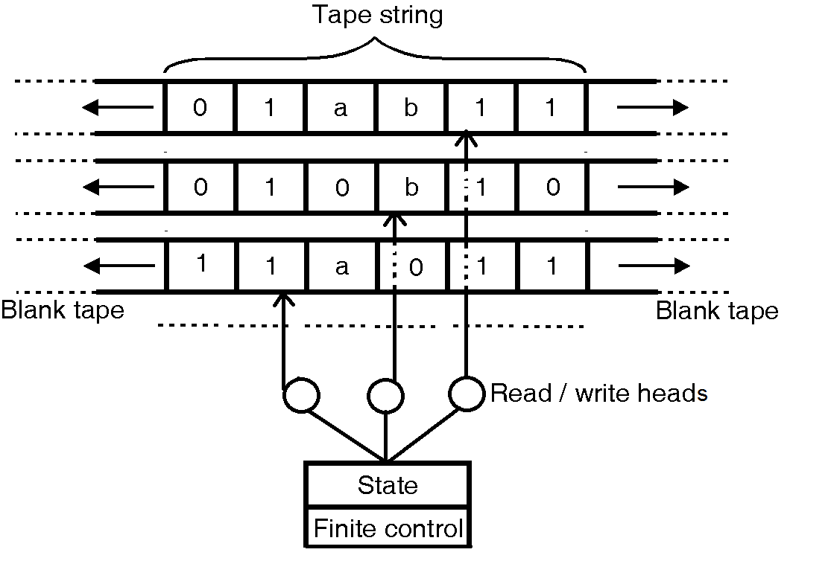
Multi Tape Turing Machine
 Multi-tape Turing machines have k number of independent tapes, having their own read/write heads. These machines have independent control over all the heads—any of these can move and read/write their own tapes. All these tapes are unbounded at both the ends just as in the single- tape TM.
 Multi-tape TM and single-tape TM are equivalent in power (except for some difference in execution time

Slide 62
Universal Turing Machine
Universal Turing Machine (UTM)
 Turing machine that can simulate any other Turing Machine
 It accepts the encoded Functional Matrix of any other TM as input on
its tape (Program area)
 It also accepts the data on which the other TM needs to be simulated (Data area of the tape)
 UTM needs an imitation algorithm that can simulate the functional
matrix of any other TM (System area)
 Functional Matrix of such a UTM is analogous to an Operating System
 UTM is analogous to a modern Computer!

Slide 63
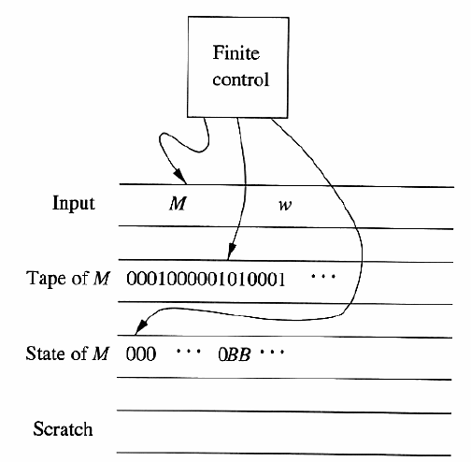
Universal Turing Machine

Slide 64
Tape 1
Three tapes
Description of
Universal
Turing
Machine
Tape 2
Tape Contents of
Tape 3
State of

Slide 65
Non-Deterministic Turing Machine
A nondeterministic Turing Machine (NTM) differs from the deterministic variety by having a transition function δ such that for each state q and tape symbol X, δ(q, X) is a set of triples
{(q₁,Y₁,D₁), (q₂,Y₂,D₂), ……….. (q_{k},Y_{k},D_{k})}
Where k is any finite integer. The NTM can choose, at each step, any of the triples to be the next move. It cannot, however, pick a state from one, a tape symbol from another, a the direction from yet another.

Slide 66
NTM and DTM
Theorem: Every NTM has an equivalent (deterministic) TM
Proof: Simulate NTM with a deterministic TM
C_{start}
computations of M are a tree
nodes are configurations
fanout is b = maximum number of choices in transition function
leaves are accept/reject configurations.
rej
acc

Slide 67
Simulating NTM M with a deterministic TM:
Breadth-first search of tree
if M accepts: we will encounter accepting leaf and accept
if M rejects: we will encounter all rejecting leaves, finish traversal of tree, and reject
if M does not halt on some branch: we will not halt as that branch is infinite…
Simulating NTM M with a deterministic TM:
  use a 3 tape TM:
    tape 1: input tape (read-only)
    tape 2: simulation tape (copy of M’s tape at point corresponding to some node in the tree)
    tape 3: which node of the tree we are exploring (string in {1,2,…b}*)
  Initially, tape 1 has input, others blank

Slide 68
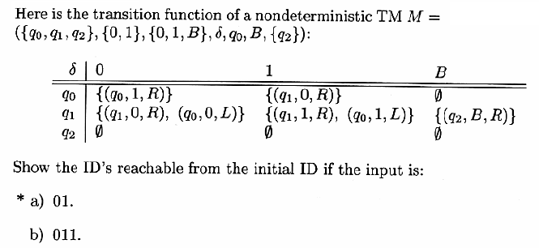
NTM and DTM

Slide 69
END

